Slide 1
10 Statistical Inference Concerning Two Populations
Business Statistics:
Communicating with Numbers, 4e
By Sanjiv Jaggia and Alison Kelly
Copyright 2022 © McGraw Hill LLC. All rights reserved. No reproduction or distribution without the prior written consent of McGraw Hill LLC.

Slide 2
Chapter 10 Learning Objectives (L Os)
L O 10.1 Make inferences about the difference between two population means based on independent sampling.
L O 10.2 Make inferences about the mean difference based on matched-pairs sampling.
L O 10.3 Make inferences about the difference between two population proportions based on independent sampling.

Slide 3
Introductory Case: Effectiveness of Mandatory Caloric Postings 1
In March 2010, federal health-care law required chain restaurants with 20 locations or more to post caloric information on their menus.
This would make it easier for consumers to select healthier food options.
Nutritionist Molly Hosler would like to study the effects of a recent local menu ordinance requiring caloric postings in San Mateo, California.
Molly obtains transaction data for 40 customers at a popular cafe around the time that San Mateo implemented the ordinance.

Slide 4
Introductory Case: Effectiveness of Mandatory Caloric Postings 2
Here is some of the sample data.
Customer | Drink Calories for Before | Drink Calories for After | Food Calories for Before | Food Calories for After
1 | 141 | 142 | 395 | 378
2 | 137 | 140 | 404 | 392
… | … | … | … | …
40 | 147 | 141 | 406 | 400
Molly wants to use the sample information to:
Determine whether average calories of purchased drinks declined after the passage of the ordinance.
Determine whether average calories of purchased food declined after the passage of the ordinance.
Assess the implications of caloric postings for cafes.

Slide 5
10.1 Inference Concerning the Difference Between Two Means 1
Independent random samples are samples that are completely unrelated to one another.
The process that generates one sample is completely separate from the process that generates the other sample.
The samples are clearly delineated.
Example: difference between male and female salaries.
For one sample, collect data from the male population.
For the other sample, collect data from the female population.
The selection of one is not influenced by the selection of the other.

Slide 6
10.1 Inference Concerning the Difference Between Two Means 2
Previously, we use a sample statistic to estimate a population parameter.
The sample mean
is the point estimator for the population mean
For statistical inference about
had to be normally distributed or
approximately normally distributed.
Sample data from a normal population.
Large sample size (at least 30)

Slide 7
10.1 Inference Concerning the Difference Between Two Means 3
We want a confidence interval for the difference between two population means
The difference between the sample means
is the point estimator for
The values of the sample means are computed from two independent random samples with n₁ and n₂ observations.
For statistical inference about
the sampling distribution of
has to be normally distributed or approximately normally distributed.
Sample from two independent normally distributed populations.
Sample from two independent populations

Slide 8
10.1 Inference Concerning the Difference Between Two Means 4
is as unbiased estimator for
Three cases regarding the population variances.
are known, use z for statistical inference.
are unknown but assumed equal
are unknown but assumed unequal
The confidence interval follows the standard format.
Point Estimate ± Margin of Error.
Margin of error includes z or t_{df} multiplied by

Slide 9
10.1 Inference Concerning the Difference Between Two Means 5
The
confidence interval depends on the variances.
Variances known:
Variances unknown, assumed equal:
Uses the pooled estimate
df = n₁ + n₂ − 2.

Slide 10
10.1 Inference Concerning the Difference Between Two Means 6
Variances unknown, assumed unequal:

Slide 11
10.1 Inference Concerning the Difference Between Two Means 7
Example: A consumer advocate analyzes the nicotine content in two brands of cigarettes.
Construct the 95% confidence interval for the difference between the two population means.
Nicotine content is assumed to be normally distributed.
In addition, the population variances are unknown but assumed equal.

Slide 12
10.1 Inference Concerning the Difference Between Two Means 8
Example, continued.
The 95% confidence interval for the difference between the two means ranges from −0.41 to −0.13.

Slide 13
10.1 Inference Concerning the Difference Between Two Means 9
Let d₀ be a hypothesized difference for
The competing hypothesis will be one of the below.
In most cases, d₀ = 0.
In this scenario, the test determines if the two means differ, one is greater than the other, or one is less than the other.

Slide 14
10.1 Inference Concerning the Difference Between Two Means 10
The test statistic depends on the variances.
Variances known:
Variances unknown, assumed equal:
Variances unknown, assumed unequal:

Slide 15
10.1 Inference Concerning the Difference Between Two Means 11
Example: the annual returns (in %) for 10 firms in the gold industry and 10 firms in the oil industry.
Gold | Oil
6 | −3
15 | 15
… | …
16 | 15
Can we conclude at the 5% significance level that the average returns in the two industries differ?
Here we assume that the sample data are drawn independently from normally distributed populations.
The variance is a common measure of risk when analyzing financial returns and we cannot assume that the risks are equal.

Slide 16
10.1 Inference Concerning the Difference Between Two Means 12
Example, continued.
Let
denote the mean return for the gold industry.
Let
denote the mean return for the oil industry.
We wish to test whether the mean returns differ.
Given we assume the variances are unknown and different, use,
Excel and R provide the degrees of freedom, the test statistic, and the p-value.

Slide 17
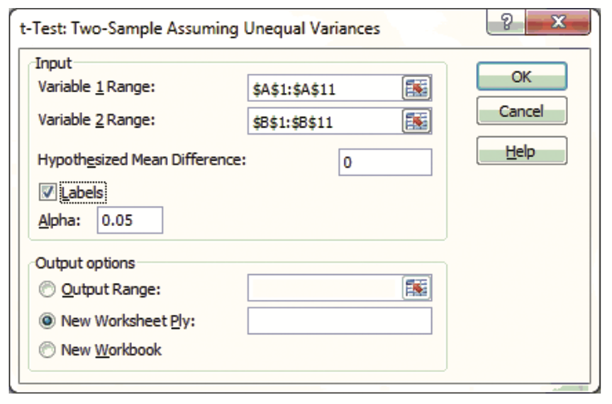
10.1 Inference Concerning the Difference Between Two Means 13
Example, continued with Excel.
Data > Data Analysis > t-Test: Two-Sample Assuming Unequal Variances > OK.
Access the text alternative for slide images.

Slide 18
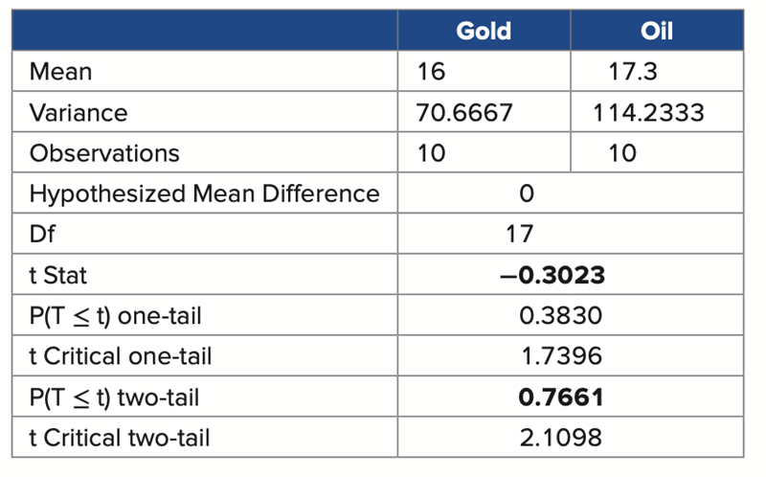
10.1 Inference Concerning the Difference Between Two Means 14
Example, continued with Excel.
Compute the confidence interval:
−1.3 ± 9.07.
Access the text alternative for slide images.

Slide 19

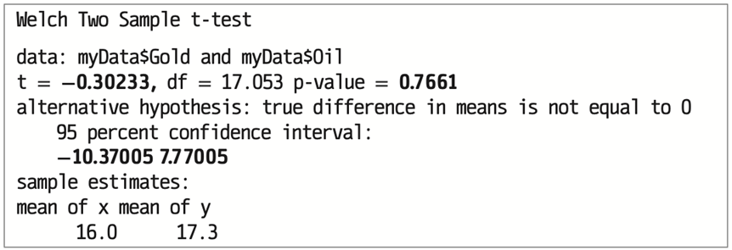
10.1 Inference Concerning the Difference Between Two Means 15
Example, continued with R.
The confidence interval is [−10.37, 7.77].
The p-value is 0.7661, we cannot reject the null hypothesis.
At the 5% significant level, we cannot conclude the average returns between the gold and oil industries differ.
Access the text alternative for slide images.

Slide 20
10.2 Inference Concerning Mean Differences 1
One crucial assumption for inferences about
is the samples are
drawn independently.
A common case of dependent sampling is matched pairs.
Samples are paired or matched in some way.
Comparison is between “apples” and ”apples.”
“Before” and “after” studies.
A measurement, intervention, another measurement.
Example: measuring the weight of clients before and after a diet plan.
A pairing of observations.
Not the same individual who gets sampled twice.
Example: 20 adjacent plots of land using a nonorganic fertilizer on one half of the plot and an organic fertilizer on the other.

Slide 21
10.2 Inference Concerning Mean Differences 2
The parameter of interest is the mean difference.
Denote the mean difference as
D = X₁ − X₂, X₁ and X₂ are a matched pair.
Inference is based on the sample mean difference
X₁ − X₂ normally distributed or a large sample size.
follows (approximately) a normal distribution.
and s_{D} are the mean and standard deviation of the differences.
df = n − 1.

Slide 22
10.2 Inference Concerning Mean Differences 3
Example: A manager is interested in improving productivity at a plant by changing the layout of the workstation.
For each of 10 workers, she measures the time it takes to complete a task before the change and again after the change.
She calculates
Construct the 95% confidence interval for the mean difference.
Assume that the productivity variable, before minus after, is normally distributed.

Slide 23
10.2 Inference Concerning Mean Differences 4
Example, continued.
The 95% confidence interval for the mean difference ranges from 0.36 to 16.64.
This represents a fairly wide interval, caused by the high standard deviation 10 sample differences.

Slide 24
10.2 Inference Concerning Mean Differences 5
Let d₀ be a hypothesized difference for
The competing hypothesis will be one of the below.
In most cases, d₀ = 0.
Test statistic:
This test is equivalent to finding differences between the paired items and using one-sample t-test.

Slide 25
10.2 Inference Concerning Mean Differences 6
Example: Chain restaurants are required to post caloric information on their menus.
A nutritionist wants to examine whether average drink calories declined at a popular cafe after the caloric postings.
The nutritionist obtains transaction data for 40 customers and records each customer’s drink calories prior to the caloric postings and then after the caloric postings.
Can she conclude at the 5% significance level that the ordinance reduced average drink calories?

Slide 26
10.2 Inference Concerning Mean Differences 7
Example, continued.
Let X₁ denote drink calories before caloric postings.
Let X₂ denote drink calories after caloric postings.
D = X₁ − X_{2.}
Compute

Slide 27
10.2 Inference Concerning Mean Differences 8
Example, continued.
We want to test if the mean difference is greater than zero
The p-value is
With Excel: T.DIST.RT(1.629, 39).
With R: pt(1.629, 39, lower.tail=FALSE).
The p-value is 0.056, do not reject the null hypothesis.
At the 5% significance level, we cannot conclude that posting of caloric information decreases average drink calories.

Slide 28
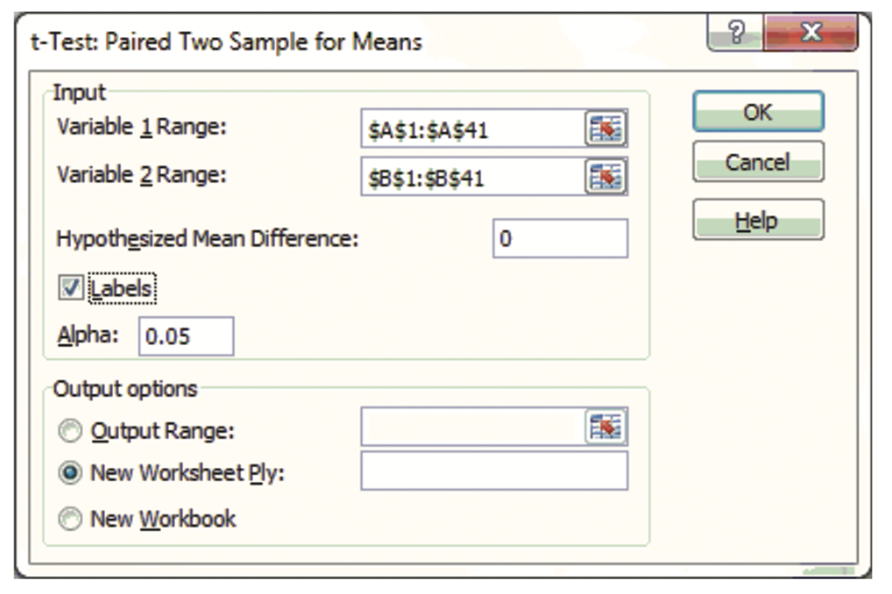
10.2 Inference Concerning Mean Differences 9
Example, continued with Excel.
Data > Data Analysis > t-Test: Paired Two Sample for Means.
Access the text alternative for slide images.

Slide 29
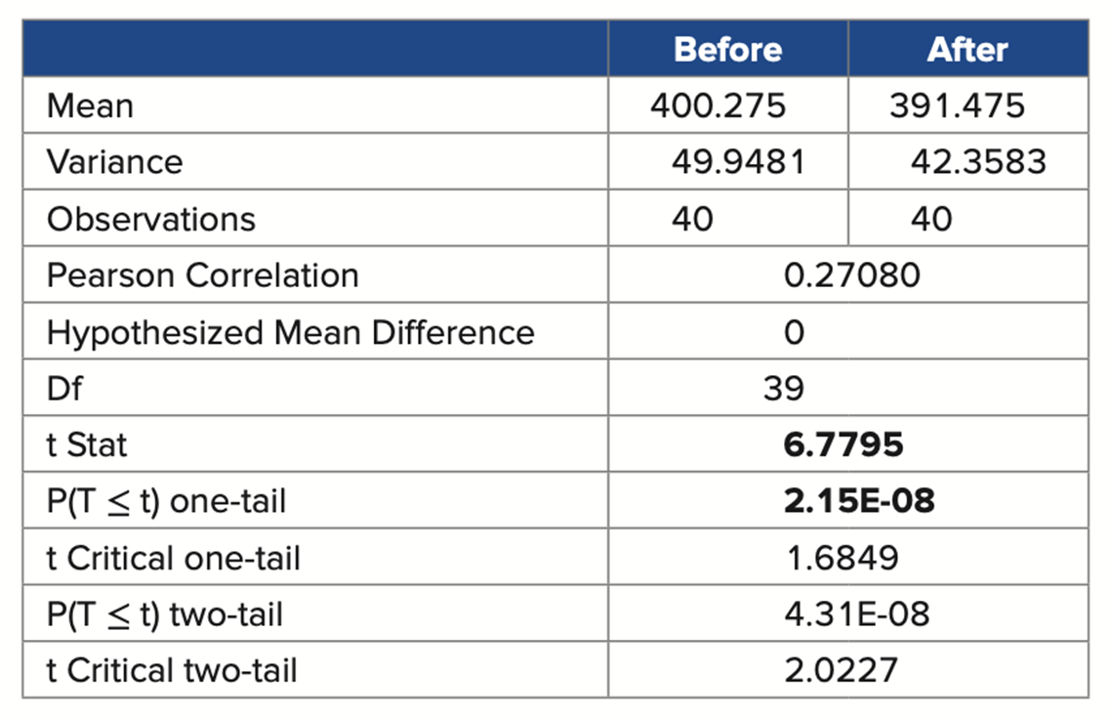
10.2 Inference Concerning Mean Differences 10
Example, continued with Excel.
Access the text alternative for slide images.

Slide 30
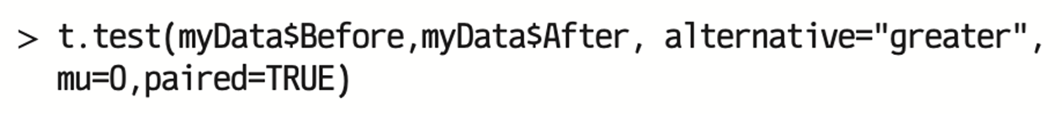
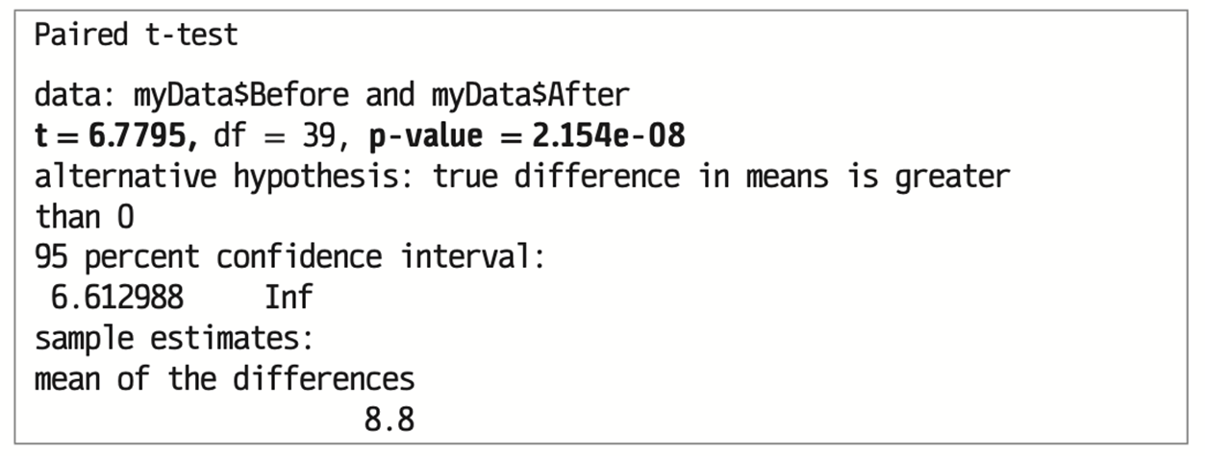
10.2 Inference Concerning Mean Differences 11
Example, continued with R.
Access the text alternative for slide images.

Slide 31
10.3 Inference Concerning the Difference Between Two Proportions 1
Like with inferences for
we consider inferences for p₁ − p₂
under independent sampling.
The estimator for p₁ − p₂ is
If n₁ and n₂ are sufficiently large, the sampling distribution of
can be approximated by the normal distribution.
For independent samples, the standard error is

Slide 32
10.3 Inference Concerning the Difference Between Two Proportions 2
A
confidence interval for p₁ − p₂:
Since the population proportions are not known, use the sample proportions
to estimate
in the margin of error.
Valid when
are all at least 5.

Slide 33
10.3 Inference Concerning the Difference Between Two Proportions 3
Example: Despite his inexperience, Candidate A appears to have gained support among the electorate.
Three months ago, in a survey of 120 registered voters, 55 said that they would vote for Candidate A.
Today, 41 registered voters in a sample of 80 said that they would vote for Candidate A.
Construct the 95% confidence interval for the difference between the two population proportions.

Slide 34
10.3 Inference Concerning the Difference Between Two Proportions 4
Example, continued.
z_{0.025} = 1.96.
The confidence interval is
With 95% confidence, we can report that the percentage change of support for the candidate is between −8.70% and 19.54%.

Slide 35
10.3 Inference Concerning the Difference Between Two Proportions 5
Let d₀ be a given hypothesized difference for p₁ − p₂.
The competing hypothesis will be one of the below.
In most cases, d₀ = 0.
The estimated
depends on d₀.
When d₀ = 0, p₁ = p₂.
Sample proportions are estimates of the same unknown population proportion.
Standard error can be improved by computing the pooled estimate based on a larger sample.

Slide 36
10.3 Inference Concerning the Difference Between Two Proportions 6
The estimated test statistics in each case depend on d₀.
This uses the pooled estimate, based on a larger sample size.

Slide 37
10.3 Inference Concerning the Difference Between Two Proportions 7
Example: An analyst claims that the proportion of men who regularly make online purchases is greater than the proportion of women.
Of the 6,000 men that the analyst surveyed, 5,400 of them said they regularly make online purchases.
8,600 of the 10,000 women surveyed regularly make online purchases.
Test the analyst’s claim at the 5% significance level.

Slide 38
10.3 Inference Concerning the Difference Between Two Proportions 8
Example, continued.
Let p₁ denote the proportion of men who make online purchases.
Let p₂ denote the proportion of women who make online purchases.
We wish to test the below competing hypotheses.

Slide 39
10.3 Inference Concerning the Difference Between Two Proportions 9
Example, continued.
Since d₀ = 0, compute the pooled estimate.

Slide 40
10.3 Inference Concerning the Difference Between Two Proportions 10
Example, continued.
The p-value is
which is approximately zero.
Reject the null hypothesis.
At the 5% significance level, the analyst’s claim is supported by the sample data; that is, the proportion of men is greater than the proportion of women.
The results appear consistent with the decision by so many retailers to redesign their websites to attract male customers.

Slide 41
10.3 Inference Concerning the Difference Between Two Proportions 11
Example: While we expect relatively expensive wines to have more desirable characteristics than relatively inexpensive wines, people are often confused in their assessment of the quality of wine in a blind test.
In a recent experiment at a local winery, the same wine is served to two groups of people but with different price information.
In the first group, 60 people are told that they are tasting a $25 wine, of which 48 like the wine.
In the second group, only 20 of 50 people like the wine when they are told that it is a $10 wine.
The experiment is conducted to determine if the proportion of people who like the wine in the first group is more than 20 percentage points higher than in the second group.
Conduct this test at the 5% significance level.

Slide 42
10.3 Inference Concerning the Difference Between Two Proportions 12
Example, continued.
Let p₁ denote the proportion of people who like the wine in the first group.
Let p₂ denote the proportion of people who like the wine in the second group.

Slide 43
10.3 Inference Concerning the Difference Between Two Proportions 13
Example, continued.
The p-value is
Reject the null hypothesis.
At the 5% significance level, we conclude that the proportion of people who like the wine in the first group is more than 20 percentage points higher than in the second group.
Overall, this result is consistent with scientific research, which has demonstrated the power of suggestion in wine tasting.

Slide 44
End of Main Content
Copyright 2022 © McGraw Hill LLC. All rights reserved. No reproduction or distribution without the prior written consent of McGraw Hill LLC.

Slide 45
Accessibility Content: Text Alternatives for Images

Slide 46
10.1 Inference Concerning the Difference Between Two Means 13 – Text Alternative
Return to parent-slide containing images.
The inputs are the variable 1 and 2 ranges. The hypothesized mean difference is 0. The box for labels is checked and alpha is 0.05. The output is selected to be a new worksheet ply.
Return to parent-slide containing images.

Slide 47
10.1 Inference Concerning the Difference Between Two Means 14 – Text Alternative
Return to parent-slide containing images.
A Table has 10 Rows and 2 columns. The columns have the following headings from left to right. Gold, Oil. The Row entries are as follows.
Row 1. Mean. Gold, Oil, 16,17.3.
Row 2. Variance. Gold, Oil, 70.6667, 114.2333.
Row 3. Observations. Gold, Oil, 10,10.
Row 4. Hypothesized mean difference. Gold, Oil, 0.
Row 5. Df. Gold, Oil, 17.
Row 6. t Stat. Gold, Oil, negative 0.3023.
Row 7. P(T less than or equal to t) one-tail. Gold, Oil, 0.3830.
Row 8. t Critical one-tail. Gold, Oil, 1.7396.
Row 9. P(T less than or equal to t) two-tail. Gold, Oil, 0.7661.
Row 10. t Critical two-tail. Gold, Oil, 2.1098.
Return to parent-slide containing images.

Slide 48
10.1 Inference Concerning the Difference Between Two Means 15 – Text Alternative
Return to parent-slide containing images.
For first image, program code. In the code, the words in the variable names are merged. Line 1. > t.test, left parenthesis, myDatadollarGold, comma, myDatadollarOil, comma, alternative = open quotes, two.sided, close quotes, comma. Line 2. mu = 0, comma, paired = FALSE, comma, var.equal = FALSE, comma, conf.level = 0.95, right parenthesis.
For second image, program code. In the code, the words in the variable names are merged. Line 1. Welch Two Sample t, hypen, test. Line 2. data, colon, myDatadollarGold and myDatadollarOil. Line 3. t = negative 0.30233, comma, df = 17.053 p, hypen, value = 0.7661. Line 4. alternative hypothesis, colon, true difference in means is not equal to 0. Line 5. indended once, 95 percent confidence interval, colon. Line 6. indended once, negative 10.37005 7.77005. Line 7. sample estimates, colon. Line 8. mean of x mean of y. Line 9. indended once, 16.0 7.3.
Return to parent-slide containing images.

Slide 49
10.2 Inference Concerning Mean Differences 9 – Text Alternative
Return to parent-slide containing images.
The inputs are the variable 1 and 2 ranges. The hypothesized mean difference is 0. The box for labels is checked and alpha is 0.05. The output is selected to be a new worksheet ply.
Return to parent-slide containing images.

Slide 50
10.2 Inference Concerning Mean Differences 10 – Text Alternative
Return to parent-slide containing images.
A Table has 11 Rows and 2 columns. The columns have the following headings from left to right. Before, After. The Row entries are as follows.
Row 1. Mean. Before, After, 400.275,391.475.
Row 2. Variance. Before, After, 49.9481, 42.3583.
Row 3. Observations. Before, After, 40,40.
Row 4. Person Correlation. Before, After, 0.27080.
Row 5. Hypothesized mean difference. Before, After, 0.
Row 6. Df. Before, After, 39.
Row 7. t Stat. Before, After, 6.7795.
Row 8. P(T less than or equal to t). Before, After, 2.15E.08.
Row 9. t Critical one-tail. Before, After, 1.6849.
Row 10. P(T less than or equal to t) two-tail. Before, After, 4.31E-08.
Row 11. t Critical two-tail. Before, After, 2.0227.
Return to parent-slide containing images.

Slide 51
10.2 Inference Concerning Mean Differences 11 – Text Alternative
Return to parent-slide containing images.
For first image, program code. In the code, the words in the variable names are merged. Line 1. > t.test, left parenthesis, myDatadollarBefore, comma, myDatadollarAfter, comma, alternative = open quotes, greater, close quotes, comma. Line 2. mu = 0, comma, paired = TRUE, right parenthesis.
For second image, program code. In the code, the words in the variable names are merged. Line 1. Paired t, hypen, test. Line 2. data, colon, myDatadollarBefore and myDatadollarAfter. Line 3. t = 6.7795, comma, df = 39, p, hypen, value = 2.154e, hypen, 08. Line 4. alternative hypothesis, colon, true difference in means is greater. Line 5. than 0. Line 6. 95 percent confidence interval, colon. Line 7. indended once, 6.612988 Inf. Line 8. sample estimates, colon. Line 9. mean of the differences. Line 10. indended once, 8.8.
Return to parent-slide containing images.

